Slide 1
Problem Statement:-
Customer satisfaction has emerged as one of the most important factors that guarantee the success of online store; it has been posited as a key stimulant of purchase, repurchase intentions and customer loyalty. A comprehensive review of the literature, theories and models have been carried out to propose the models for customer activation and customer retention. Five major factors that contributed to the success of an e-commerce store have been identified as: service quality, system quality, information quality, trust and net benefit. The research furthermore investigated the factors that influence the online customers repeat purchase intention. The combination of both utilitarian value and hedonistic values are needed to affect the repeat purchase intention (loyalty) positively. The data is collected from the Indian online shoppers. Results indicate the e-retail success factors, which are very much critical for customer satisfaction.

Slide 2
EDA steps and visualizations:-
EDA
#Printing their object type and their unique values
for column in df:
if df[column].dtype==object:
print(str(column)+' : '+str(df[column].unique()))
print(df[column].value_counts())
print("********************************************************************")
print('\n’)
#Plot Pie chart male vs female
# calculate their age group
# pie chart of shopping duration
#types of sites online used
#method of access to online sites of shopping
#logged in promotions
#delivery period
#payment method

Slide 3
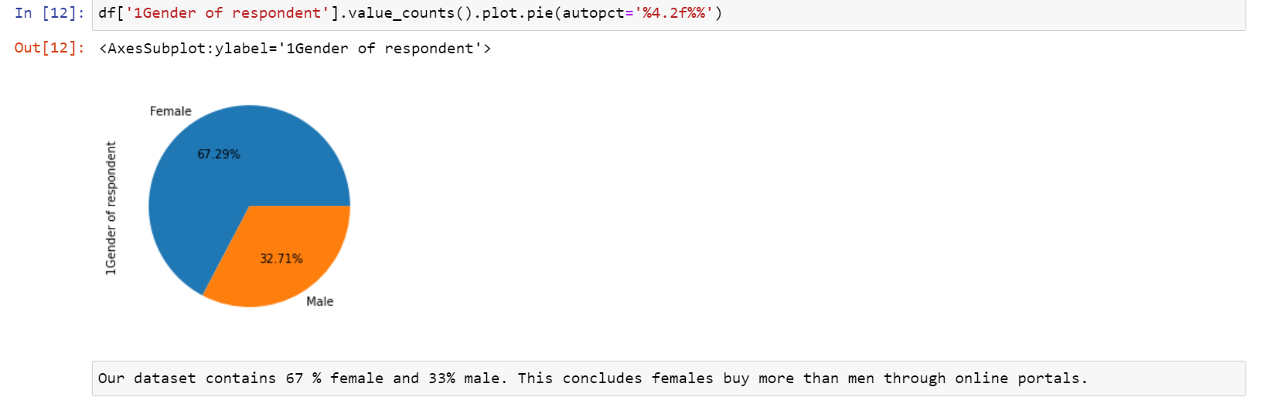
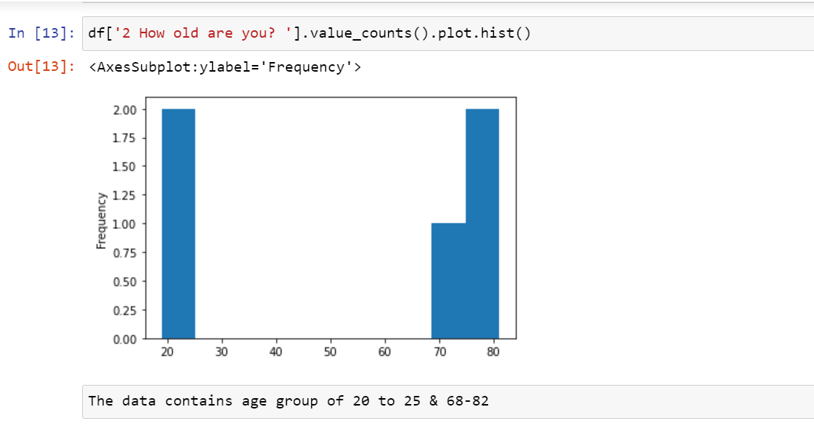

Slide 4
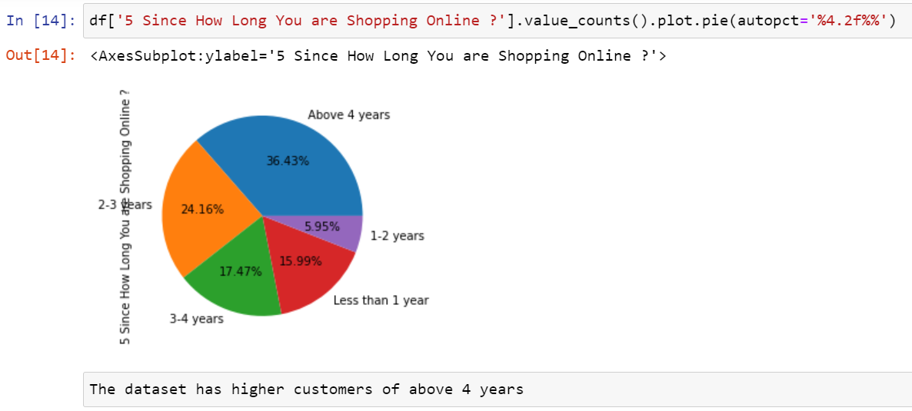
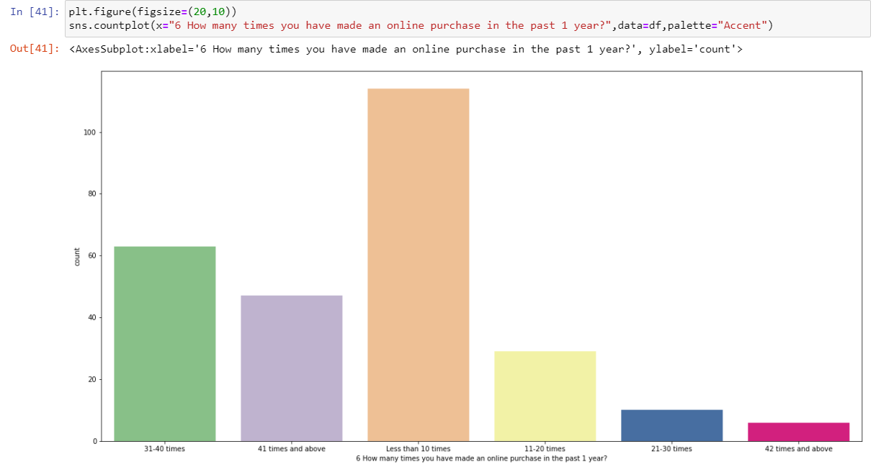

Slide 5
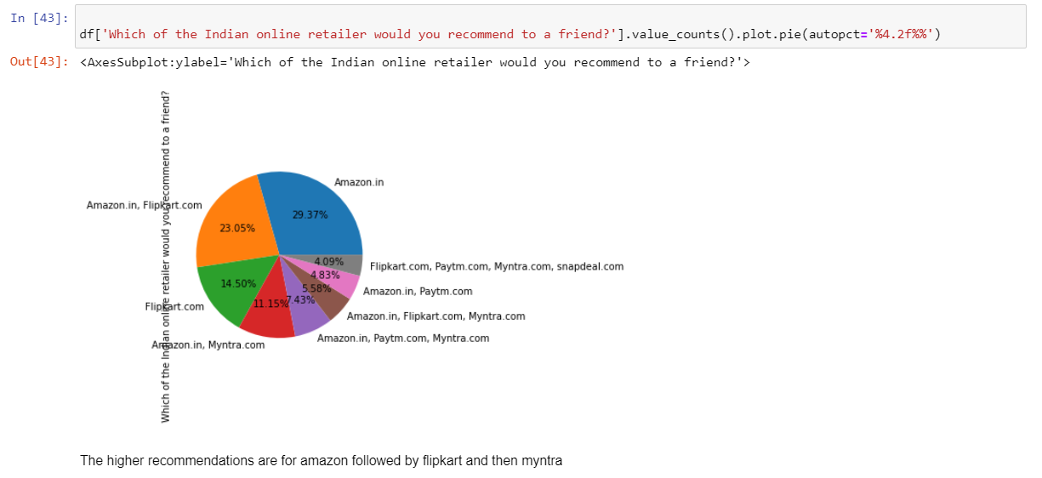
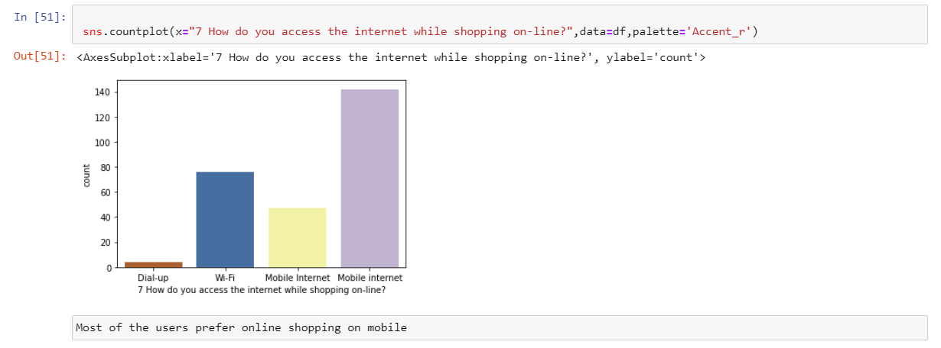

Slide 6
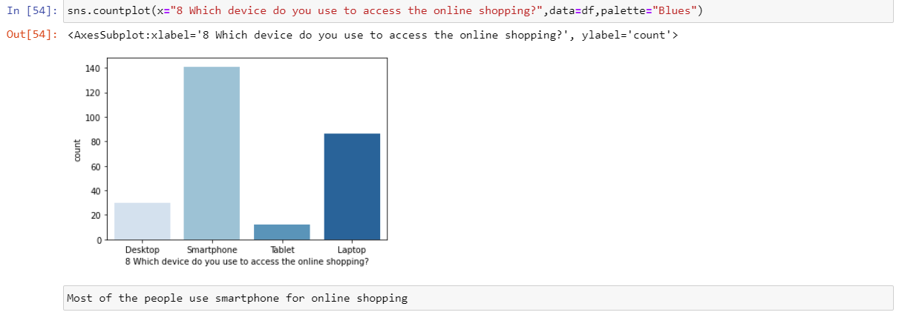
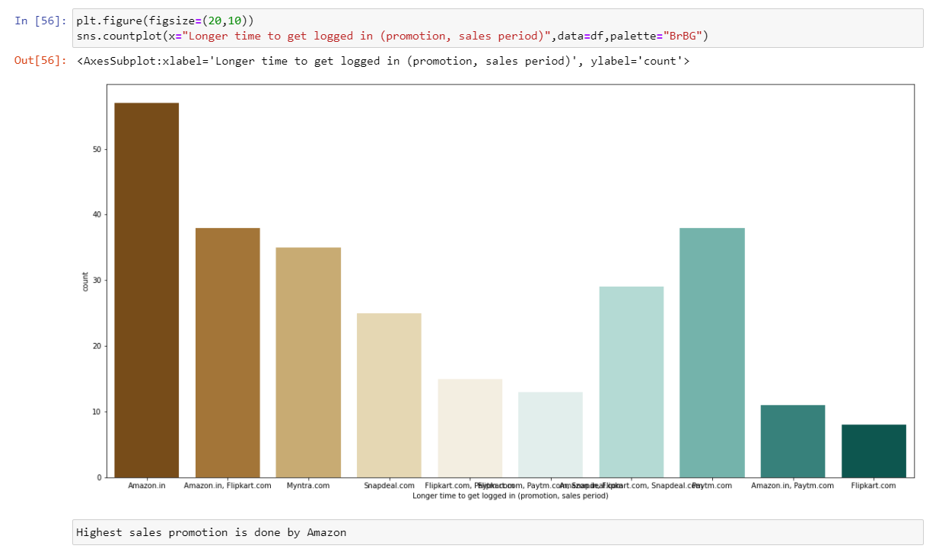

Slide 7
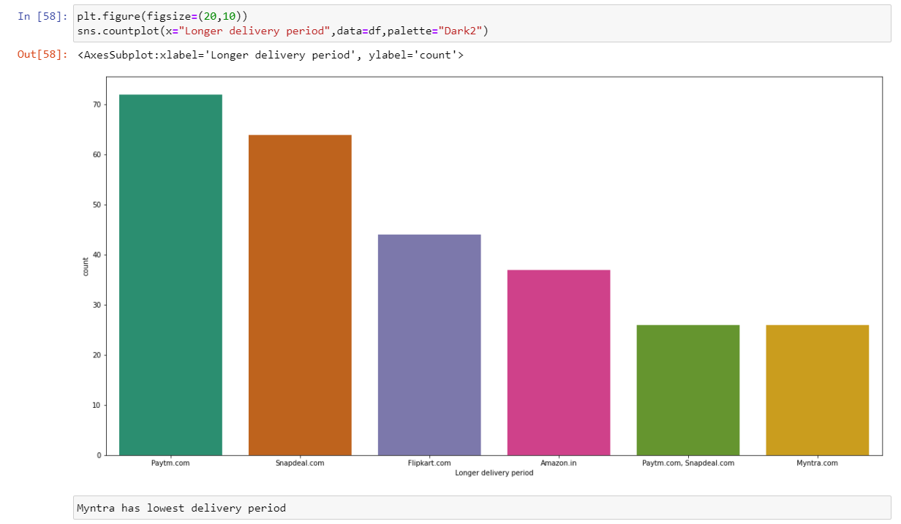
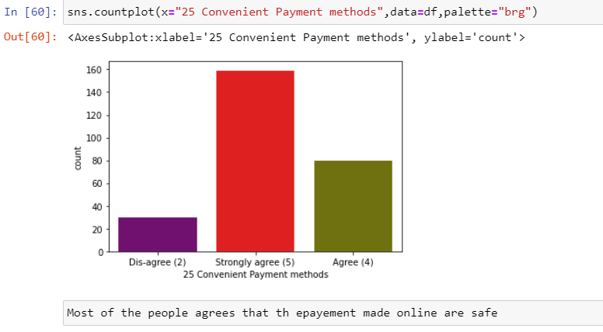

Slide 8
Conclusion:-
#Most of the people agrees that the epayement made online are safe
#Myntra has lowest delivery period
#Highest sales promotion is done by Amazon
#Most of the people use smartphone for online shopping
#Very few customers who have purchased more that 42 times , theere more number of custometrs who have purchased less than 10 times
#The dataset has higher customers of above 4 years
#Our dataset contains 67 % female and 33% male. This concludes females buy more than men through online portals.

